Slide 1


Nelson City – Overview of Demographic Trends
Dr Natalie Jackson
Director, Natalie Jackson Demographics Ltd.
Invited address to nelson city council, nelson
October 27th 2017

Slide 2

Outline
Population ageing – what it is, what it means
Migration and natural increase
Joining the dots.. Implications for growth
Implications for labour supply and housing
Broader context/change in components of growth/implications for Nelson’s longer-term growth

Slide 3
Nelson City – one of NZ’s ‘older’ TAs
Observed
Projected
Source: Author/Stats NZ 2016, 2017 (2013-Base – 2043 Update)

Slide 4
Population of Nelson City currently 22nd oldest of 67 Territorial Authority Areas (TAs)
There is considerable ‘ageing-in-place’ along with sizeable retirement migration
40% of Nelson’s growth 1996-2016 came from growth in the 65+ years population
Age Structure
65+ years: 18.9% (1996 = 14.1%)
Statistics NewZealand ERP

Slide 5
Nelson slightly younger than Tasman and Marlborough (and Buller, Hurunui)
65+ years: 20.3% (1996 = 12.3%)
65+ years: 22.3% (1996 = 14.2%)
Statistics NewZealand ERP

Slide 6
Age structures and rates of structural ageing differ greatly across the country
65+ years: 11.8% (1996 = 10.1%)
65+ years: 10.1% (1996 = 8.6%)
Statistics NewZealand ERP

Slide 7
What does it mean to age ‘structurally’?
Population ageing in four dimensions:
        Increased numbers at older ages due to increasing longevity = ‘numerical ageing’
        Increased proportions at older ages due to declining birth rates + numerical ageing = ‘structural ageing’
        Structural ageing reduces ‘natural increase’
        More elderly than children >> more deaths than births >> natural decrease >> end of growth >> depopulation
Structural ageing and the ending of growth may be accelerated by migration
  Migration-driven loss of young adults/gain of retirees accelerates structural ageing, hastens the end of natural increase – both are directly affecting Nelson City and surrounding districts

Slide 8
Nelson already has more elderly than children
Observed
Projected
Source: Statistics New Zealand, Estimated Resident Population;(1996-2013) ;Subnational Population Projections: 2013(base)–2043 (Update)

Slide 9
The 65+ population will account for all of Nelson’s future growth (+ surrounds)

Slide 10
Summary – Nelson’s ageing in context
1996-2016 Nelson had 18th fastest growth rate
  Tasman 13th, Marlborough 20th
Nelson currently 22nd ‘oldest’ of 67 TAs
  However Marlborough 6th, Tasman 14th
Nelson City ageing faster than many, projected to be 14th oldest by 2043
  However Tasman 2nd, Marlborough 9th
  Nelson thus ‘old’ but surrounded by even older areas (+Buller, Hurunui..); implications for growth, labour supply, housing

Slide 11
Nelson City – has been growing steadily + recent increase in growth rate

Slide 12
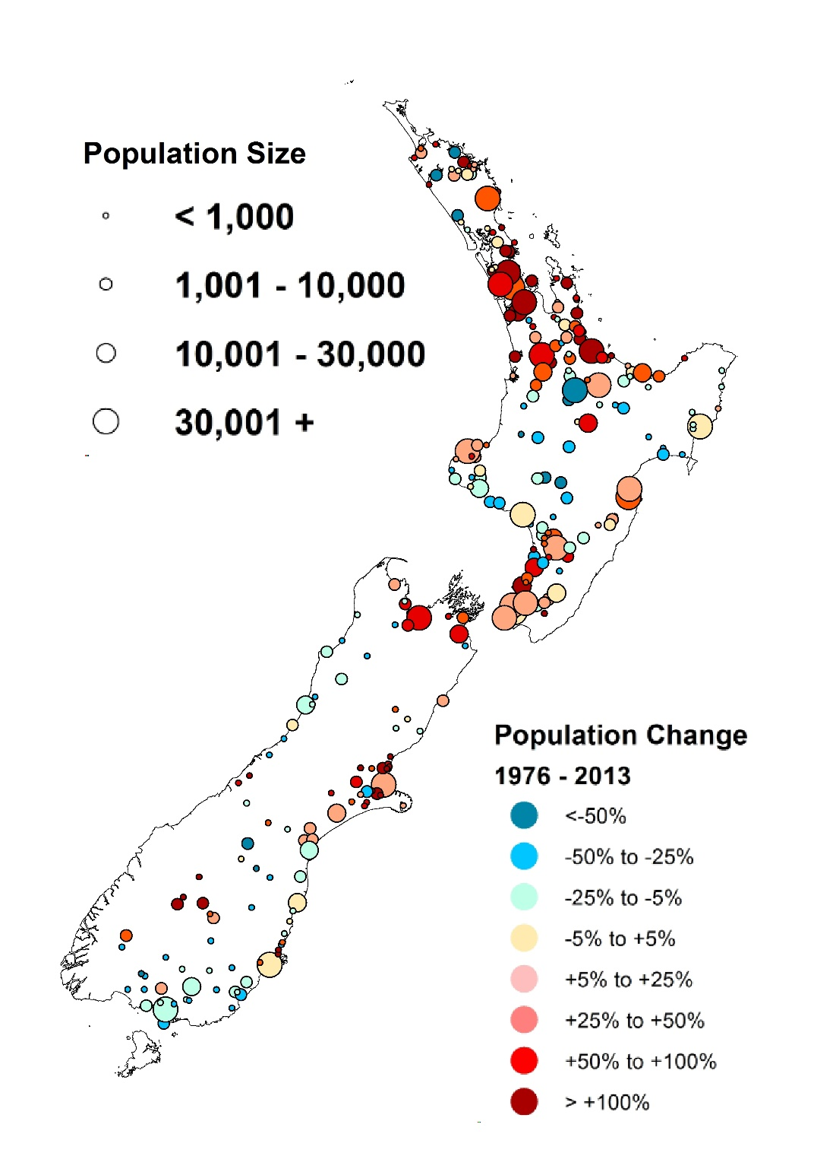
Net change in population size 1976-2013
Nelson, Tasman and Marlborough have been among the ‘winners’ 1976-2013

Slide 13
Nelson’s growth is projected to level off around 2030
Observed
Projected

Slide 14
Most of Nelson’s growth has been from migration
Canterbury Earthquakes
Source: Stats NZ Births, Deaths, ERP (Note change of timing and method of enumeration between 1995 and 1996 means that only natural increase can be shown for that year)

Slide 15
Nelson made a ‘novel’ gain from the Canterbury earthquakes
% Net Internal migration FROM Christchurch
2008-2013: +63%
2001-2006: -42%
1996-2001: -16%
1991-1996: -40%
Net Gain
Net Loss

Slide 16
Most of Nelson’s migrants are families with children, and increasingly retirees; Nelson loses its young

Slide 17
Nelson is not alone in losing its young

Slide 18
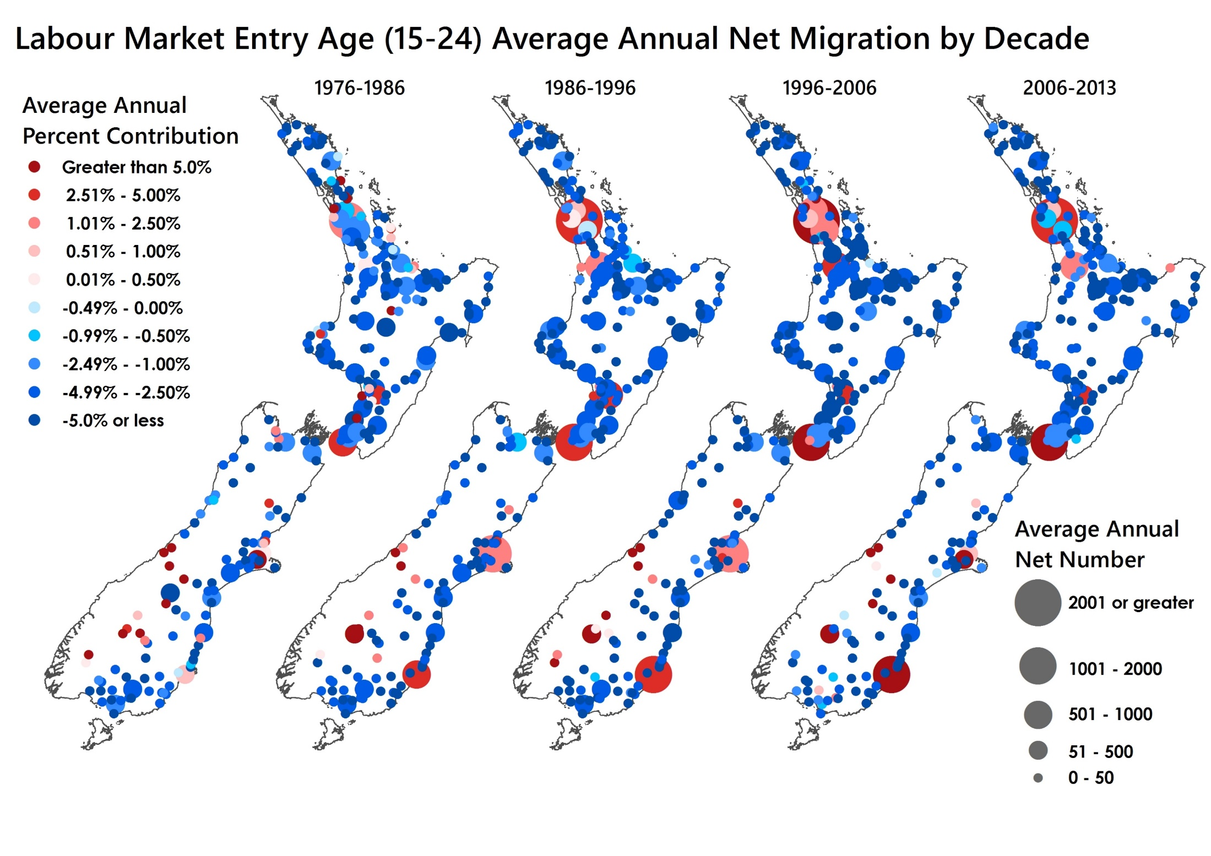

Slide 19
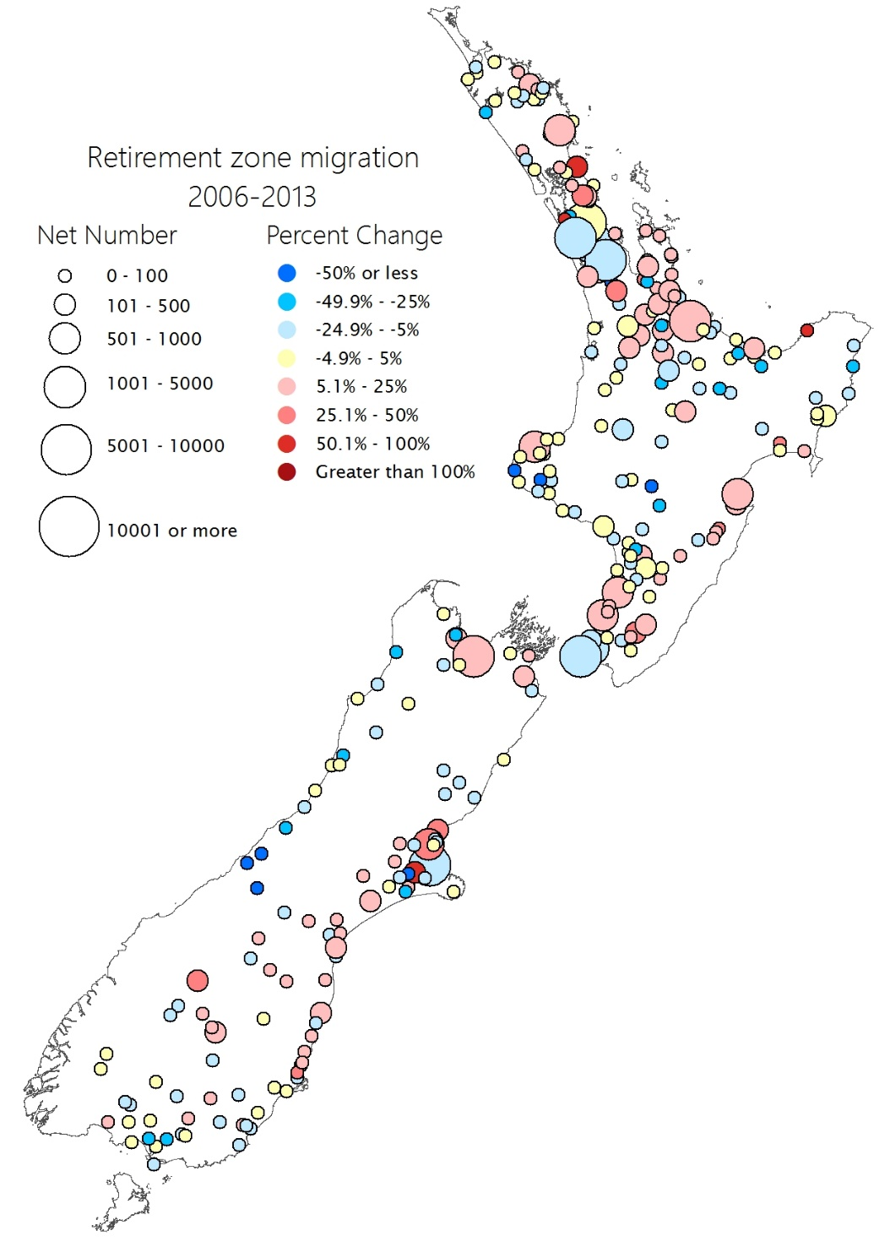
Net internal migration at 65+ years, 2006-2013
RETIREE SUN-BELT MIGRATION IS INCREASING

Slide 20
Until recently, the vast majority of Nelson’s migrants were ‘internal’

Slide 21
Nelson consistently loses population to Tasman, gains it from Marlborough

Slide 22
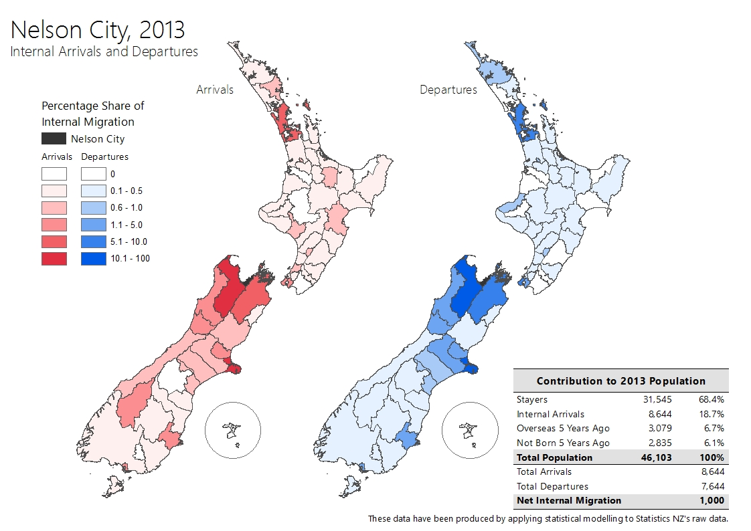
Data are available by age and sex, four census periods

Slide 23

Joining the dots..
Age Structure
Natural Increase
MIGRATION

Slide 24
Ageing and labour supply

Slide 25
Most TAs will soon have more elderly than children (65+ : 0-14 years); Marlborough, Nelson and Tasman already among them
Observed Projected (Medium variant)
Source: Statistics New Zealand, Estimated Resident Population;(1996-2013) ;Subnational Population Projections: 2013(base)–2043 (Update)
Author/Statistics NZ 2017 Subnational population projections (2013-base 2043 Update)

Slide 26
Most TAs already have more people at labour market exit age (60-69 years) than entry age (20-29 years); Nelson, Marlborough and Tasman among them
Observed Projected (Medium variant)
Gen TGYH arrives
Nelson
Tasman, Marlborough
Source: Statistics New Zealand, Estimated Resident Population;(1996-2013) ;Subnational Population Projections: 2013(base)–2043 (Update)
Author/Statistics NZ 2017 Subnational population projections (2013-base 2043 Update)

Slide 27
Local labour market supply is unlikely to grow appreciably
Author/Statistics NZ 2017 Subnational population projections (2013-base 2043 Update)

Slide 28
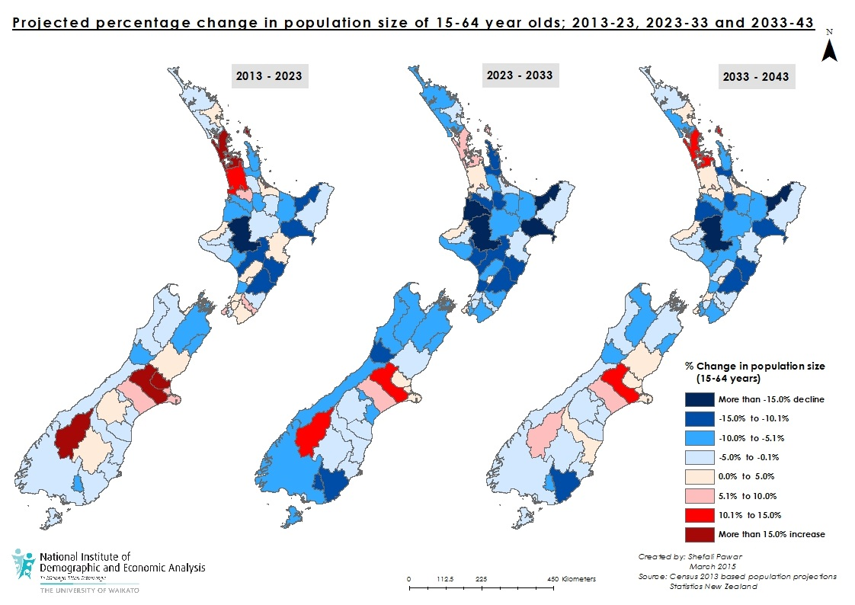
NZ’s ‘prime’ working age population (15-64 years) is projected to shrink significantly in many areas. By 2023, 46% of NZ’s WAPs are projected to be smaller than in 2013 (but 13% larger at national level); by 2043, 67% WAPs smaller than in 2013 (but 23% larger at national level)

Slide 29
Ageing and housing

Slide 30
Ageing and housing
As structural ageing progresses, average household(HH) size falls
  More older people are widowed, live alone
  Later family formation means fewer per HH
  Fewer children means empty nest stage is reached earlier
Nelson’s 2013 average of 2.4 persons per HH projected to fall to 2.3 (2018) then 2.2 (c. 2033)
Family Type and HH mix differs by township
Need to ensure appropriate housing mix

Slide 31
Household size
Author/Statistics New Zealand Subnational Household Projections (Medium)

Slide 32
Housing tenure is changing
67.6

Slide 33
Can migration resolve these issues?

Slide 34

Nelson has increasingly gained from migration
Source: (Jackson and Brabyn 2017) Tai Timu Tangata: Taihoa e?

Slide 35
Even HUGE migration numbers cannot prevent structural ageing
Source: Jackson and Cameron 2017

Slide 36
Migration is more likely to make areas older rather than younger – this affects Nelson (although less than Tasman and Marlborough)
Jackson and Brabyn (forthcoming) Age-selective migration and population ageing..
Source: (Jackson and Brabyn 2017) Tai Timu Tangata: Taihoa e?

Slide 37
TAs younger/older with migration, than without
N=66
Jackson and Brabyn (forthcoming) Age-selective migration and population ageing.. (14 TAs younger)
Source: (Jackson and Brabyn 2017) Tai Timu Tangata: Taihoa e?

Slide 38

There are complex interactions between net migration and natural increase
Growth | A: Natural Increase and Net Migration are both positive
 | B: Natural Increase offsets Net Migration Loss
 | C: Net Migration Gain offsets Natural Decrease
Decline | D: Net Migration Gain fails to offset Natural Decrease
 | E: Natural Increase fails to offset Net Migration Loss
 | F: Natural Decrease and Net Migration Loss
Zero Growth | G: Natural Increase = Net Migration Loss
 | H: Natural Decrease = Net Migration Gain

Slide 39
Local causes of growth/decline differ, and are now changing due to ageing
TA | 1976-81 | 1981-86 | 1986-91 | 1991-06 | 1996-01 | 2001-06 | 2006-13 |  | 2013-18 | 2018-23 | 2023-28 | 2028-33 | 2033-38 | 2038-43
 |  | Observed 1976-2013 |  |  |  |  |  |  | Projected 2013-2043 (Medium)
NELSON | A | A | A | A | A | A | A |  | A | A | A | C | C | C
MARLBOROUGH | B | A | A | A | A | A | B |  | A | A | A | C | D | D
TASMAN | A | A | A | A | A | A | A |  | A | A | C | C | C | G
GROWTH: A (both positive); B (Natural increase offsets net migration loss); C (Migration gain offsets natural decrease)
DECLINE: D (Net migration gain fails to offset natural decrease); E (Natural increase fails to offset net migration loss); F (both negative)
Jackson and Brabyn (forthcoming) Age-selective migration and population ageing..

Slide 40
All TAs by components of growth/decline
Observed
Projected
Source: Jackson et al. forthcoming; Stats NZ, Subnational Population Projections: 2013(base)–2043 (Update)
Source: (Jackson et al) Tai Timu Tangata: Taihoa e?

Slide 41
Summary/Implications for Nelson
Nelson is assured of continued growth for the next few decades, but growth will be increasingly at 65+ years, and will slow
Being one of the older/faster ageing areas means that many other areas are younger, with potential migrant and labour supply
However contiguous location with [older] Marlborough and Tasman (and Buller, Hurunui) will make increasing local supply difficult
Older and younger areas alike will compete with Nelson for migrants/labour supply
Ageing will affect EVERYTHING and needs to be built into all aspects of planning
Notes:
41

Slide 42
Planning for a changing world
Thank you
Enquiries welcome
Email: demographics@nataliejackson.net
Website: www.nataliejackson.net

